Slide 1




Linear Data Structures: Lists
Lists, Linked List, Doubly-Linked List, List<T> Class, Collections
List Structures
SoftUni Team
Technical Trainers
Software University
http://softuni.bg

Slide 2
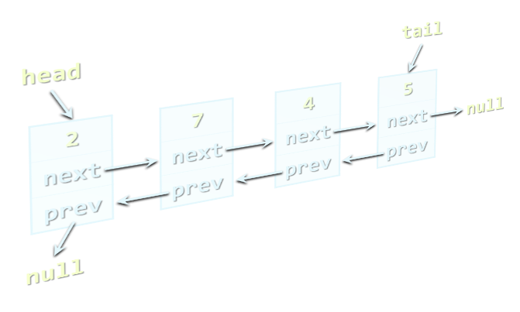

Table of Contents
Lists
Static and Linked Implementation
List<T> and LinkedList<T>
Exercise
Implementing a Linked List in C#
List Interfaces in C# and Java
.NET Collections
Java Collections Framework

Slide 3

Lists
Static and Dynamic Implementations

Slide 4
The List ADT
What is "list"?
A data structure (container) that holds a sequence of elements
Elements are arranged linearly, in a sequence
Can have variable or fixed size
"List" is abstract data type (ADT) → many implementations
Statically (using array → fixed size)
Dynamically (linked implementation)
Using resizable array (the List<T> class)

Slide 5

Static List
Implemented by an array
Provides direct access by index
Has fixed capacity (cannot append elements)
Insertion, deletion and resizing are slow operations – O(n)
Example – array of 8 elements:
0 1 2 3 4 5 6 7
L
2 | 18 | 7 | 12 | 3 | 6 | 11 | 9

Slide 6

Linked List
Dynamic (pointer-based) implementation
Different forms
Singly-linked and doubly-linked
Sorted and unsorted
Singly-linked list: each item has value and next
2
next
7
next
4
next
5
next
null
head

Slide 7
Linked List (2)
Doubly-linked list
Each item has 3 fields: value, next and prev
head
tail
2
next
prev
7
next
prev
4
next
prev
5
next
prev
null
null

Slide 8
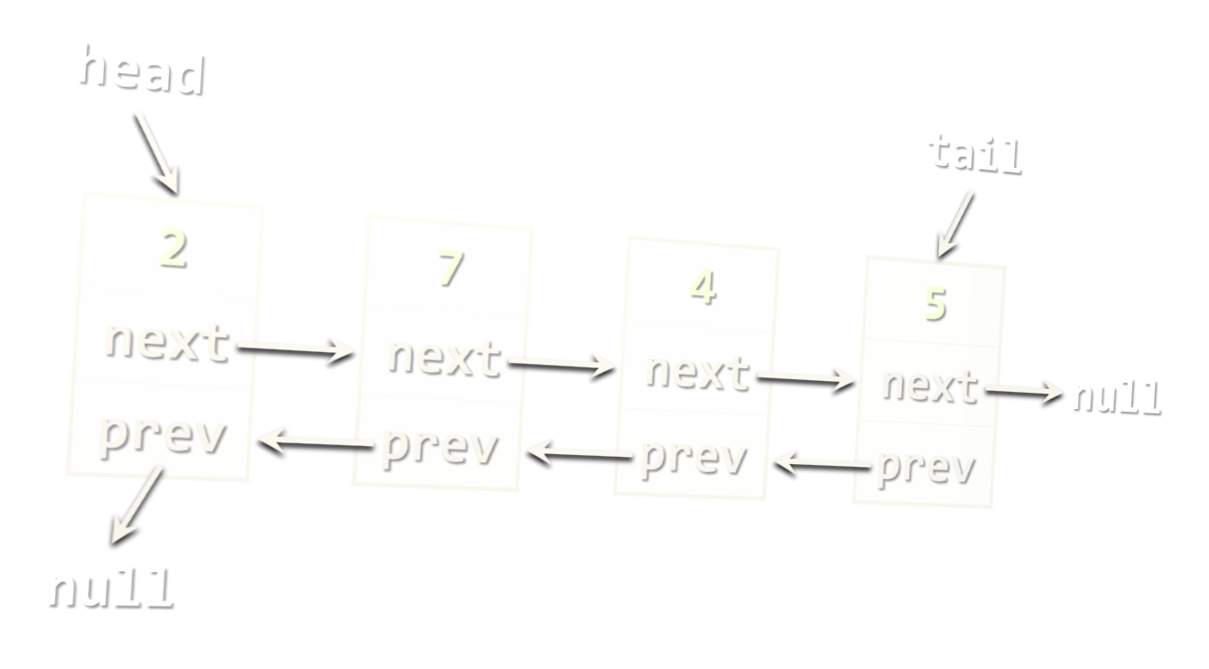
Exercise
Implement a Doubly-Linked List

Slide 9

The List<T> Class in C#
Auto-Resizable Indexed Lists

Slide 10
The List<T> Class
Implements the abstract data structure list by array + auto-grow
All elements are of the same type T
T can be any type, e.g. List<int>, List<string>, List<DateTime>
Size is dynamically increased as needed (auto-grow)
Basic functionality:
Count – returns the number of elements – O(1)
Add(T) – appends given element at the end – O(1) amortized

Slide 11
List<T> – Simple Example
static void Main()
{
var list = new List<string>() { "C#", "Java" };
list.Add("SQL");
list.Add("Python");
foreach (string item in list)
{
Console.WriteLine(item);
}
}
// Result:
// C#
// Java
// SQL
// Python

Slide 12

List<T> – Simple Example
Live Demo

Slide 13
List<T> – Functionality
list[index] – access element by index – O(1)
Insert(index, T) – inserts given element to the list at a specified position – O(n)
Remove(T) – removes the first occurrence of given element – O(n)
RemoveAt(index) – removes the element at the specified position – O(n)
Clear() – removes all elements – O(1)
Contains(T) – determines whether an element is part of the list – O(n)

Slide 14
List<T> – Functionality (2)
IndexOf(value) – returns the index of the first occurrence of a value in the list (zero-based) – O(n)
Reverse() – reverses the order of the elements in the list or a portion of it – O(n)
Sort() – sorts the list elements – O(n * log(n))
ToArray() – converts the elements of the list to an array – O(n)
TrimExcess() – sets the capacity to the actual number of elements – O(n)

Slide 15
List<T>: How It Works?
Capacity = 15
List<int>:
Count = 9
Capacity = 15
3 | 4 | 1 | 0 | 0 | 7 | 1 | 1 | 4
used buffer
(Count = 9)
unused buffer
List<T> keeps a buffer memory (capacity), allocated in advance, to allow fast Add(T)
Most operations use the buffer memory and do not allocate new objects
Occasionally the capacity grows (doubles)

Slide 16
Primes in an Interval – Example
static List<int> FindPrimes(int start, int end)
{
List<int> primesList = new List<int>();
for (int num = start; num <= end; num++)
{
bool prime = true;
for (int div = 2; div <= Math.Sqrt(num); div++)
{
if (num % div == 0)
{
prime = false;
break;
}
}
if (prime)
{
primesList.Add(num);
}
}
return primesList;
}

Slide 17
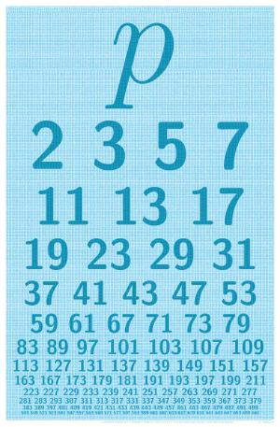
Primes in an Interval
Live Demo

Slide 18
Union and Intersection – Example
int[] Union(int[] firstArr, int[] secondArr) {
List<int> union = new List<int>();
union.AddRange(firstArray);
foreach (int item in secondArray)
if (! union.Contains(item))
union.Add(item);
return union.ToArray();
}
int[] Intersection(int[] firstArr, int[] secondArr)
{
List<int> intersect = new List<int>();
foreach (int item in firstArray)
if (Array.IndexOf(secondArray, item) != -1)
intersect.Add(item);
return intersect.ToArray();
}

Slide 19

Union and Intersection
Live Demo

Slide 20
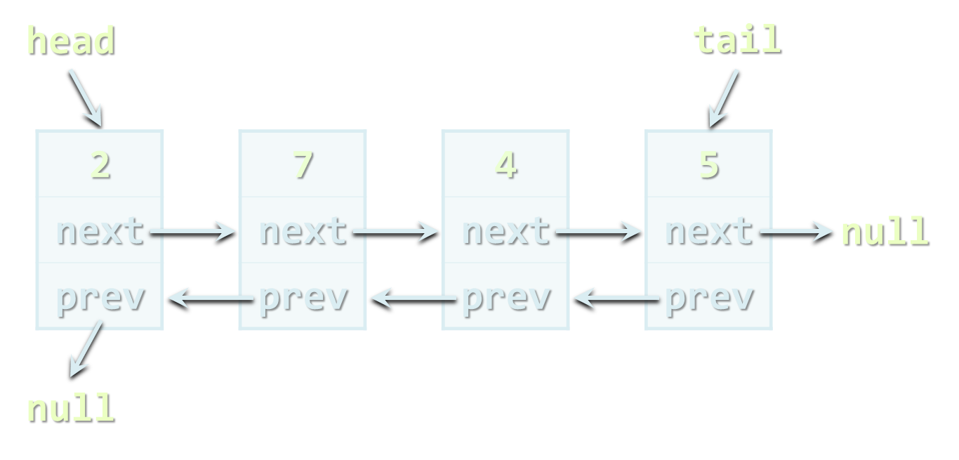
The LinkedList<T> Class in C#
Dynamic Linked List in .NET

Slide 21
The LinkedList<T> Class
Implements the abstract data structure list using a doubly-linked dynamic list structure
All elements are of the same type T
T can be any type, e.g. LinkedList<int>, LinkedList<string>, etc.
Elements can be added at both sides – O(1)
Basic LinkedList<T> functionality:
AddFirst(T), AddLast(T), AddBefore(T), AddAfter(T), RemoveFirst(T), RemoveLast(T), Count

Slide 22
LinkedList<T> – Example
static void Main()
{
var list = new LinkedList<string>();
list.AddFirst("First");
list.AddLast("Last");
list.AddAfter(list.First, "After First");
list.AddBefore(list.Last, "Before Last");
Console.WriteLine(String.Join(", ", list));
// Result: First, After First, Before Last, Last
}

Slide 23
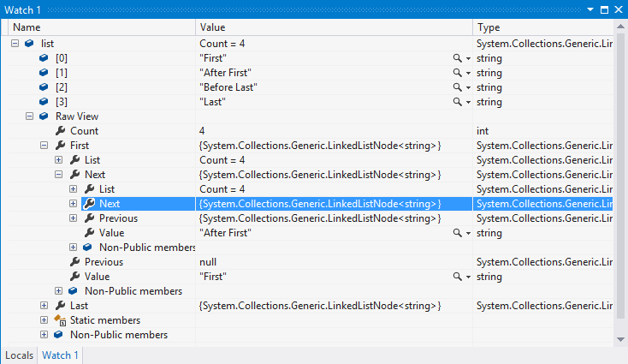
LinkedList<T>
Live Demo

Slide 24

Sorting Lists
Several Ways to Sort Lists

Slide 25
Sorting Lists
List<DateTime> list = new List<DateTime>()
{
new DateTime(2013, 4, 7),
new DateTime(2002, 3, 12),
new DateTime(2012, 1, 4),
new DateTime(1980, 11, 11)
};
list.Sort();
list.Sort((d1, d2) => -d1.Year.CompareTo(d2.Year));
list.OrderBy(date => date.Month)));

Slide 26

Sorting Lists
Live Demo

Slide 27
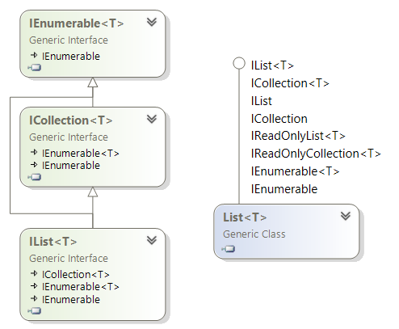
List Interfaces in .NET
IEnumerable, ICollection, IList, …

Slide 28
List Interfaces in .NET
IEnumerable, IEnumerable<T>
GetEnumerator() → Current, MoveNext()
ICollection, ICollection<T>
Inherits from IEnumerable<T>, allows modifications
Count, Add(…), Remove(…), Contains(…)
IList, IList<T>
Inherits from ICollection<T>, adds indexed access
Item / indexer [], Insert(…), RemoveAt(…), IndexOf(…)

Slide 29
.NET List Interfaces: Hierarchy

Slide 30
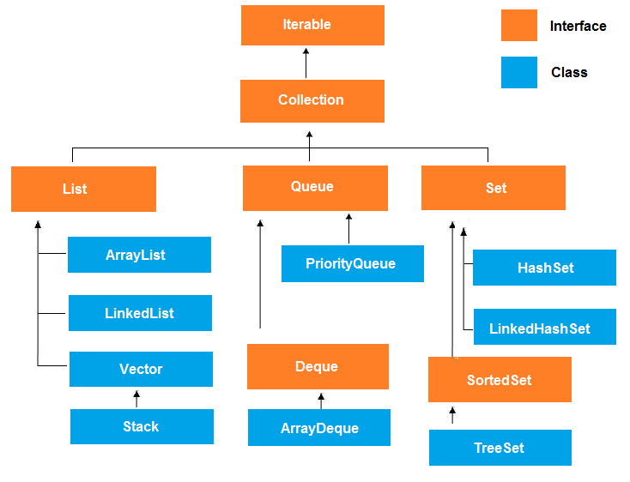
List Interfaces in Java
Lists in Java Collections Framework

Slide 31
List Interfaces in Java
Iterable<E>, Iterator<T>
iterator() → next(), hasNext()
Collection<E>
Inherits from Iterable<E>
size(), add(…), remove(…), contains(…) , clear()
List<E>
Inherits from Collection<E>, provides indexed access
get(index), set(index, item), add(index, item), remove(index), indexOf(item)

Slide 32
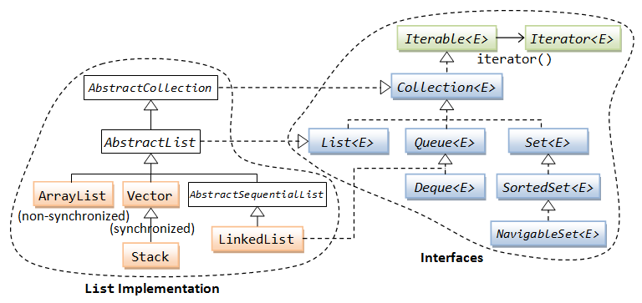
Java Collections Hierarchy

Slide 33
Summary
Lists hold sequence of elements
Linked implementation holds nodes with next / previous reference
Fast add / remove at both sides (head and tail)
Array-based implementation hold items in array + resize on grow
Collection interfaces in C# / Java
IEnumerable<T> – read-only sequence of elements
ICollection<T> – sequence of elements with add / remove
IList<T> – indexed sequence (add / remove / access by index)

Slide 34









Linear Data Structures: Lists
https://softuni.bg/trainings/1147/Data-Structures-June-2015

Slide 35
License
This course (slides, examples, labs, videos, homework, etc.) is licensed under the "Creative Commons Attribution-NonCommercial-ShareAlike 4.0 International" license
Attribution: this work may contain portions from
"Fundamentals of Computer Programming with C#" book by Svetlin Nakov & Co. under CC-BY-SA license
"Data Structures and Algorithms" course by Telerik Academy under CC-BY-NC-SA license

Slide 36






Free Trainings @ Software University
Software University Foundation – softuni.org
Software University – High-Quality Education, Profession and Job for Software Developers
softuni.bg
Software University @ Facebook
facebook.com/SoftwareUniversity
Software University @ YouTube
youtube.com/SoftwareUniversity
Software University Forums – forum.softuni.bg

